Slide 1

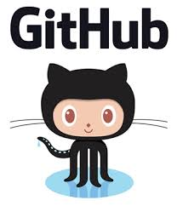
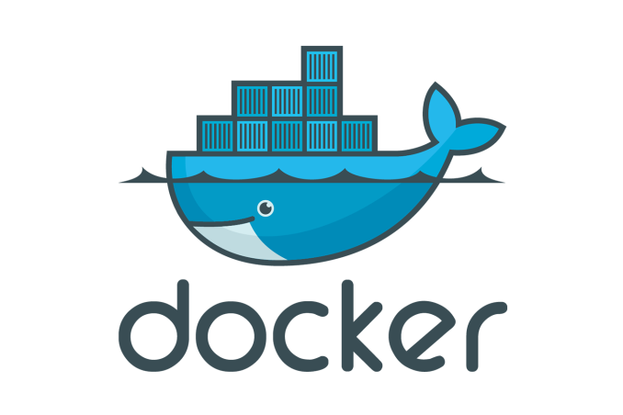
Use case 3: Docker – Git Integration
Goal: Create a Hello World Project, check it into Github and create a Docker image automatically from it and deploy it.
Introduction to Docker for Java Developers

Slide 2

Use case 3: Docker – Git Integration
Pre requisites:
Github desktop for MAC or WINDOWS to be installed
Eclipse with a running JDK (preferably JDK 8)
Basic understanding of Cloning from GIT
Continuous integration Process
Introduction to Docker for Java Developers

Slide 3

Use case 3: Docker – Git Integration
Building a Custom UBUNTU IMAGE
JDK 1.8, VI editor, mysql client, MAVEN
UBUNTU 16.04
Host Operating System (Windows, MAC OSX, Linux)
Docker Engine
Infrastructure / Server
Introduction to Docker for Java Developers

Slide 4
Use case 3: Docker – Git Integration
Step 1: Open Github desktop and create a dummy Project, check it into GIT HUB
Introduction to Docker for Java Developers

Slide 5
Use case 3: Docker – Git Integration
Step 2: Install Docker plugin for Eclipse
Introduction to Docker for Java Developers

Slide 6
Use case 3: Docker – Git Integration
Step 3: Create a docker-git-hello-world project with a package structure of org.pictolearn.docker Build an image, run a container verify the use case before understanding what GIT is going to achieve for us.
Introduction to Docker for Java Developers

Slide 7
Use case 3: Docker – Git Integration
Summary of building the custom UBUNTU image:
Think about all other use cases in your company where you can use this feature of shipping all what you want as an image which will ease the deployment process for devops engineers.
Introduction to Docker for Java Developers

Slide 8
Use case 3: Docker – Git Integration
Docker Hub does continuous integration for any changes detected on Github. It automatically creates a deployable image for you.
Introduction to Docker for Java Developers

Slide 9
Use case 3: Docker – Git Integration
Summary:
Linking Docker hub with GIT
Using Docker hub as a continuous integration server to build images.
Introduction to Docker for Java Developers

